Slide 1
Coarse graining molecular dynamics with graph neural networks CGSchNet model
Free University Berlin
ESR15

Slide 2
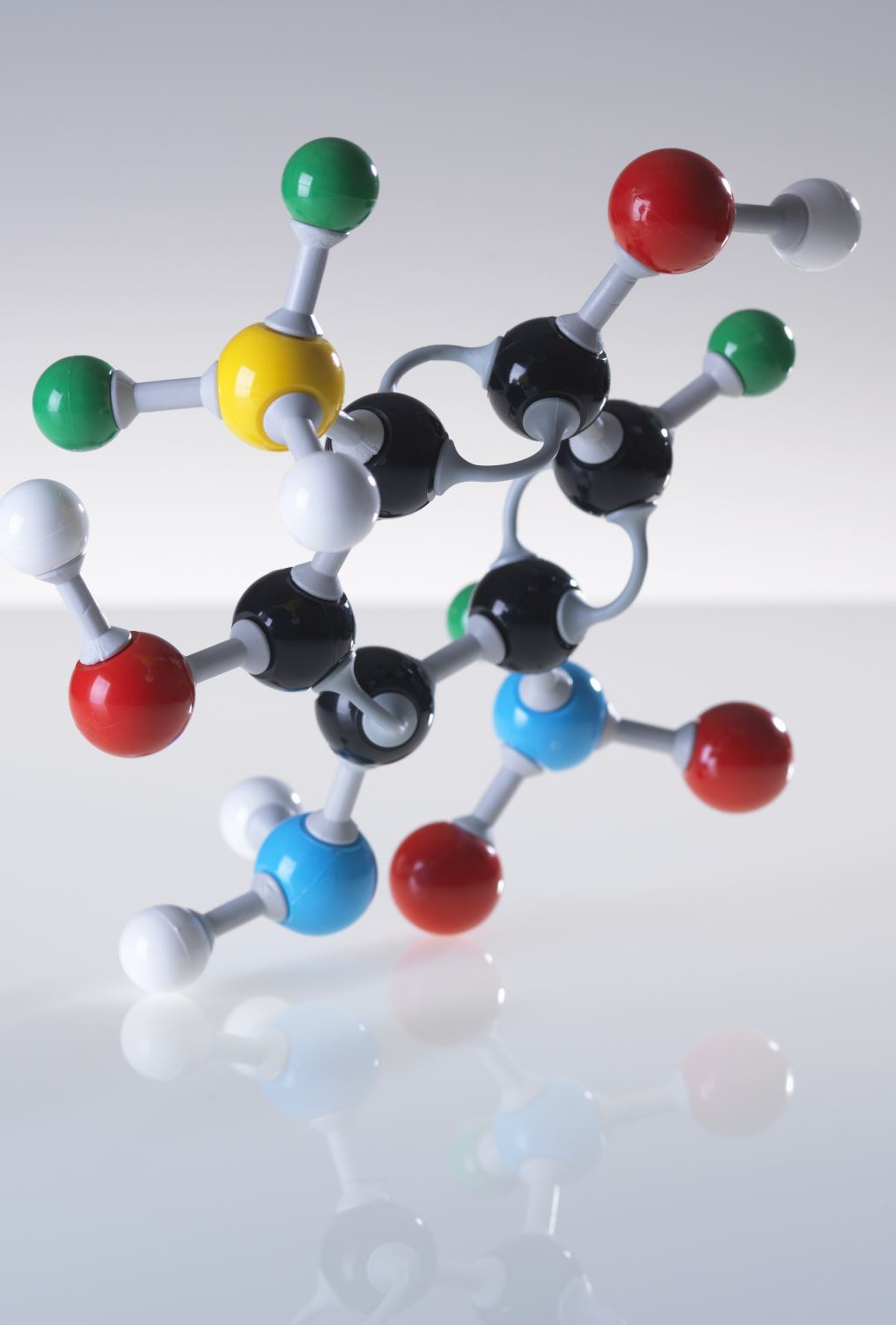
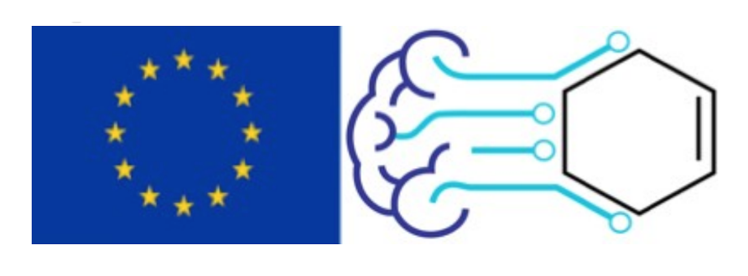
Contents
Molecular dynamics and Coarse-Graining
Motivation behind CG
Coarse-Graining variable set definitions
Variable set specifics in CGSchnet and theoretical motivation
CGNet architecture and details of implementation
CGSchnet architecture and message passing network
Simulation and assessment of network performance

Slide 3
Molecular Dynamics and Coarse-Graining
Molecular dynamics is a computer simulation method for analyzing the physical movements of atoms and molecules.(wiki)
Simulations for big size molecules are often computationally expensive. That, in turn, limits MD capabilities with too small integration step as well as iteration over the particle list.
Coarse-Graining employs next level of atom abstraction by introducing pseudo-molecules (so called beads).

Slide 4
Overview of MD abstractions

Slide 5
General structure of CG simulation process
The pipeline consist of several parts:
1) Obtain CG beads from all-atom simulation, i.e. variable set definition
2) Train CGNet with force-matching procedure
3 ) Run MD simulation utilizing CGNet as ”engine”

Slide 6
Coarse-Graining variable set definitions
Rule-based | Structure-based | ML-based
Fixed mapping using correspondence table Examples: HiRE-RNA (6-7 beads per nucleotide) YUP, NAST (1 bead per nucleotide) MARTINI (4 beads per nucleotide) | Input molecule parsed as graph, nodes in which are grouped Examples: Graph-Based Approach to Systematic Molecular Coarse-Graining Automated Coarse-Grained Mapping Algorithm for the Martini Force Field | Algorithm trained to ”predict” what original particles are most valuable through fitting procedure. Examples: Autoencoder Attention mechanism

Slide 7
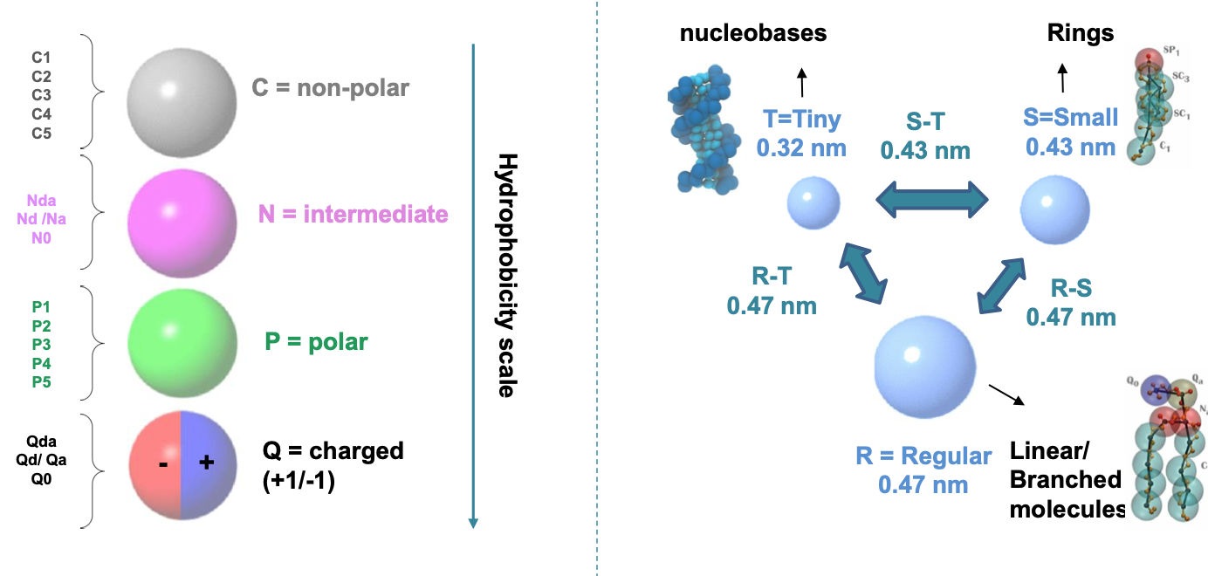
MARTINI framework
Different versions of one applied to: lipid bilayers, proteins, and polymers
Represent specific types of chemical groups according to properties such as polarity and hydrophilicity
Periole, Xavier & Marrink, Siewert. (2013). The Martini Coarse-Grained Force Field. Methods in molecular biology (Clifton, N.J.). 924. 533-65. 10.1007/978-1-62703-017-5_20.

Slide 8
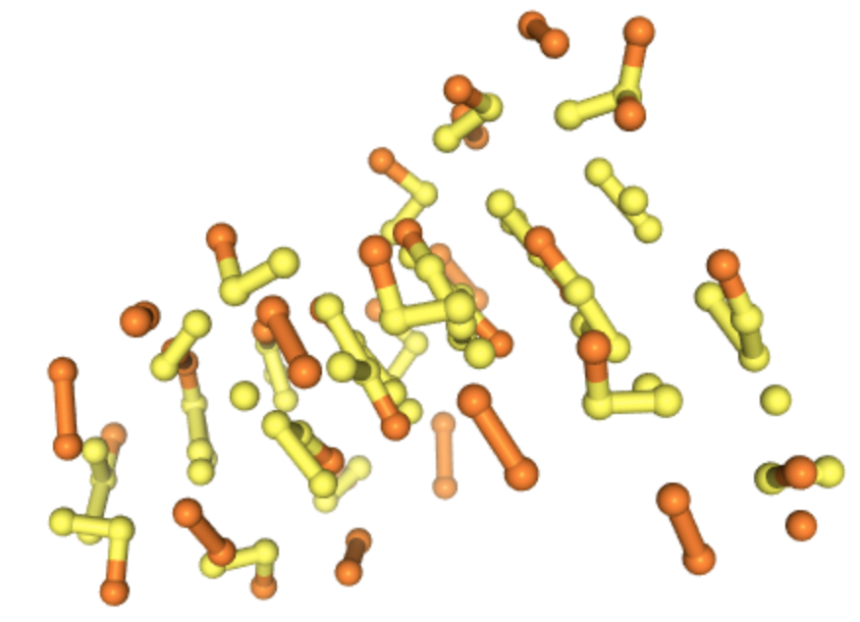
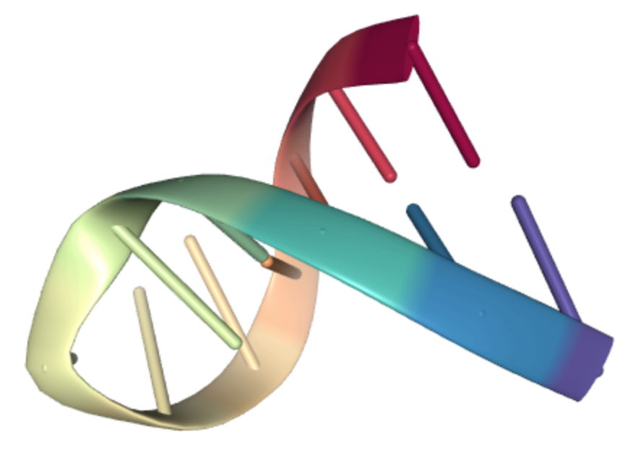
Automated mapping algorithm
This class of methods rely on mathematical (usually graph, where edges obtained by Nearest Neighbors) representation of the molecule.
Method searches patterns in the graph according to the algorithm

Slide 9
Autoencoder approach
CG variable set problem can be considered in Encoder-Decoder paradigm.
We map all-atom model to hidden space, which can be seen as “importance mask”
The optimization proceeds with following loss functions:
Differently from the other approaches, number on CG particles is a hyperparameter
Wang, Wujie & Gómez-Bombarelli, Rafael. (2019). Coarse-graining auto-encoders for molecular dynamics. npj Computational Materials. 5. 125. 10.1038/s41524-019-0261-5.

Slide 10
Summary of variable set definition methods
Martini framework:
Deterministic approach
Relies on physically/biologically reasonable assumptions
Has a fixed mapping scheme
Automated framework:
Preserve some physical features (such as symmetry)
Extremely hard to scale to the large molecules and becomes impractically slow due to the cost of enumerating all possible mapping schemes
Autoencoder approach:
Does not require any ”physics” knowledge/no guaranties for output
End-to-end training, with backward mapping
Non-deterministic
Inherits ML weaknesses, such as issues with previously unseen data

Slide 11
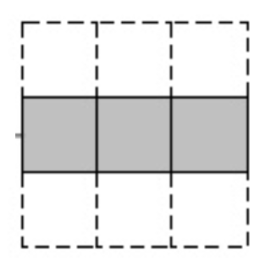
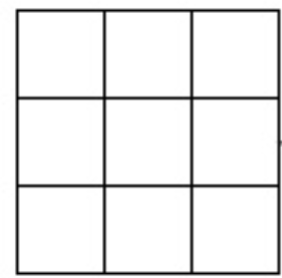
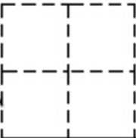
Variable set definition in CGSchnet
CGnet and, subsequently, CGSchnet variable set definition comes from multiscale coarse-graining method
All-atom positions r (N,3) mapped to beads positions x (n,3) n<N using linear mapping operator:
$$x=Ξr$$
Shape: (n, N)
Shape: (N, 3)
Shape: (n, 3)
CG beads coords
Mapping operator
Input all-atom coords
Noid, W & Chu, Jhih-Wei & Ayton, Gary & Izvekov, Sergei & Voth, Gregory & Das, Avisek & Andersen, Hans. (2008). The multiscale coarse-graining method. I. A rigorous bridge between atomistic and coarse-grained models. The Journal of chemical physics. 128. 244114. 10.1063/1.2938860.

Slide 12
Thermodynamic consistency
Denote r as all-atom configuration space, x - beads configuration space. It could be proven that coarse-grained energy U(x) that is exactly thermodynamically consistent with the atomistic energy V(r) can be expressed analytically
$$U\left(x\right)=−k∙T∙\ln{p^{cg}\left(x\right)+const}$$
$$p^{cg}\left(x\right)= \frac{\int{\exp\left(−\frac{V\left(r\right)}{kT}\right)δ\left(x −Ξr\right)dr}}{\int{\exp\left(−\frac{V\left(r\right)}{kT}\right)dr}}$$
Due to reduced degrees of freedom multiple AA configurations map to the same CG representation, contributing to energy distribution through Dirac’s delta function.
Noid, W & Chu, Jhih-Wei & Ayton, Gary & Izvekov, Sergei & Voth, Gregory & Das, Avisek & Andersen, Hans. (2008). The multiscale coarse-graining method. I. A rigorous bridge between atomistic and coarse-grained models. The Journal of chemical physics. 128. 244114. 10.1063/1.2938860.

Slide 13
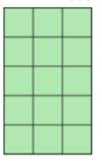
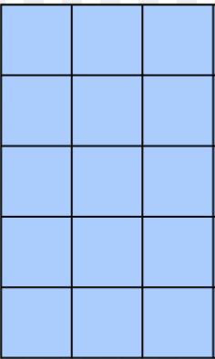
Example of CG variable set
Let’s consider chiglolin simulation data. The simplest case of mapping operator $Ξ$ that guarantees thermodynamic consistency is just elimination of certain atoms:
mol = Molecule(“chignolin.pdb”)
mol.filter("name CA")
Atoms name
'N'
'CA'
'C '
'CA'
'CB'
All-atom positions
All-atom forces, target variable

Slide 14
Force-matching/CGNet architecture
X – input coordinates;
Y - ”invariant” coordinates;
f(X) – forces;
U(X) - potential of mean force;
Free energy net – dense NN;
Prior energy – module for preventing unphysical conformations.
Wang, Jiang & Olsson, Simon & Wehmeyer, Christoph & Perez, Adrià & Charron, Nicholas & Fabritiis, Gianni & Noé, Frank & Clementi, Cecilia. (2019). Machine Learning of Coarse-Grained Molecular Dynamics Force Fields. ACS Central Science. 5. 10.1021/acscentsci.8b00913.

Slide 15
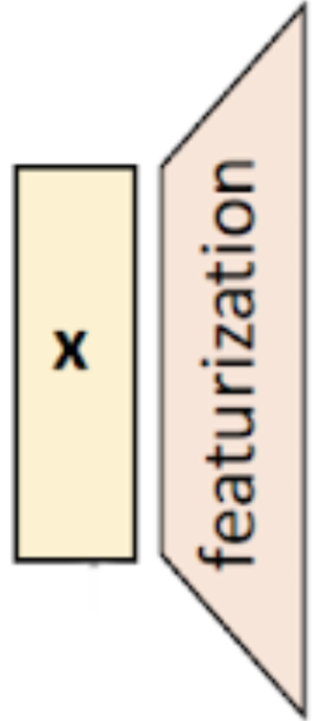
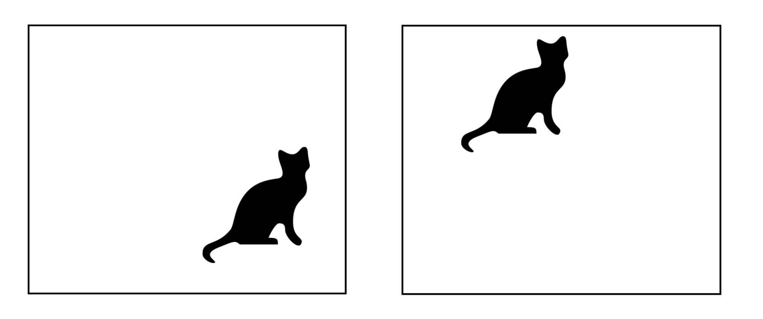
Featurization layer
Input coordinates transformed into invariant features: interatom distances, angles. Three types of invariances: translational, rotational, permutational.
Additionally, all transformations need to be differentiable and registered in computational graph.
Original Translational Rotational

Slide 16
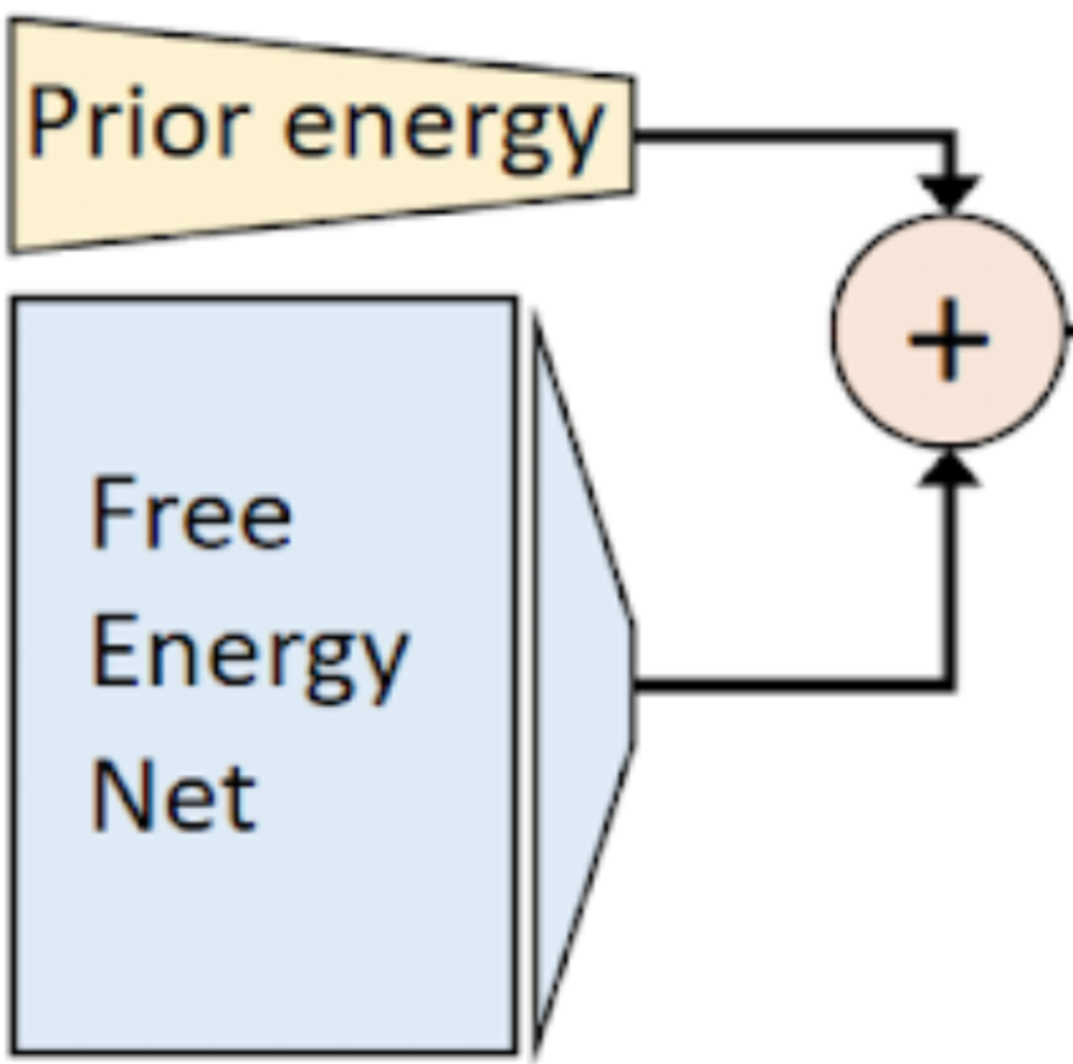
Prior energy terms
To exclude uncertainty in data, we split energy function in two terms:
$$U\left(x,θ\right)=U_{0}\left(x\right)+ U_{net}\left(x,θ\right)$$
Harmonic prior on selected distances (i.e., bonds or pseudobonds) and angles :
$$U_{repulsion}\left(r\right)= \frac{kT}{2Var\left(r\right)}{(r −𝔼\left[r\right])}^{2}$$
Repulsion prior that can be used on nonbonded distances:
$$U_{repulsion}\left(r\right)= \frac{σ^{c}}{r^{c}}$$
$σ$, $c$ – hyperparameters

Slide 17
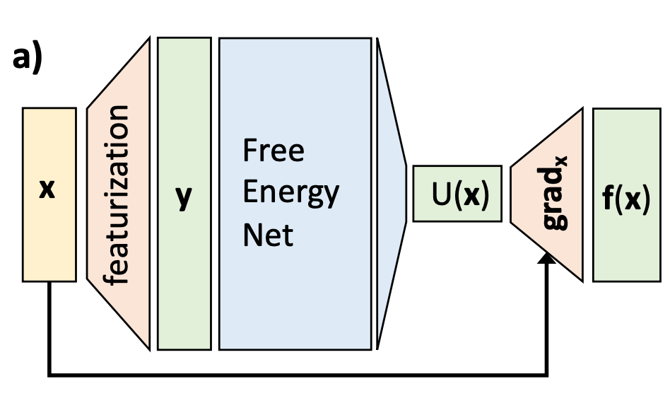
Force derivation and loss function
Force predicted by CG model:
f$\left(x,θ\right)=−∇U\left(x,θ\right)$
Force on CG bead, which is a linear combination of the atomistic forces acting on the atoms that are specific to CG bead:
$$\text{f}\left(x\right)={⟨Ξ_{F}F(r)⟩ }_{x}$$
Loss function:
$$L\left(R, θ\right)=\frac{1}{3Mn}\sum{{\left\|F_{map. all atom} − F_{predicted}\right\|}^{2}}= \frac{1}{3Mn}\sum{{\left\|Ξ_{F}F\left(r_{i}\right)+∇U\left(x_{i},θ\right)\right\|}^{2}}$$

Slide 18
CGNet summary
Utilized translational and rotational invariant features, such as interatomic distances, angles, dihedrals;
Does not obtain permutational invariance, i.e. permuting features of the same atom types affects the result;
prior energy can be applied in order to prevent the simulations with CGnets to diverge into unphysical state space regions outside the training data;
Non-transferable approach.

Slide 19
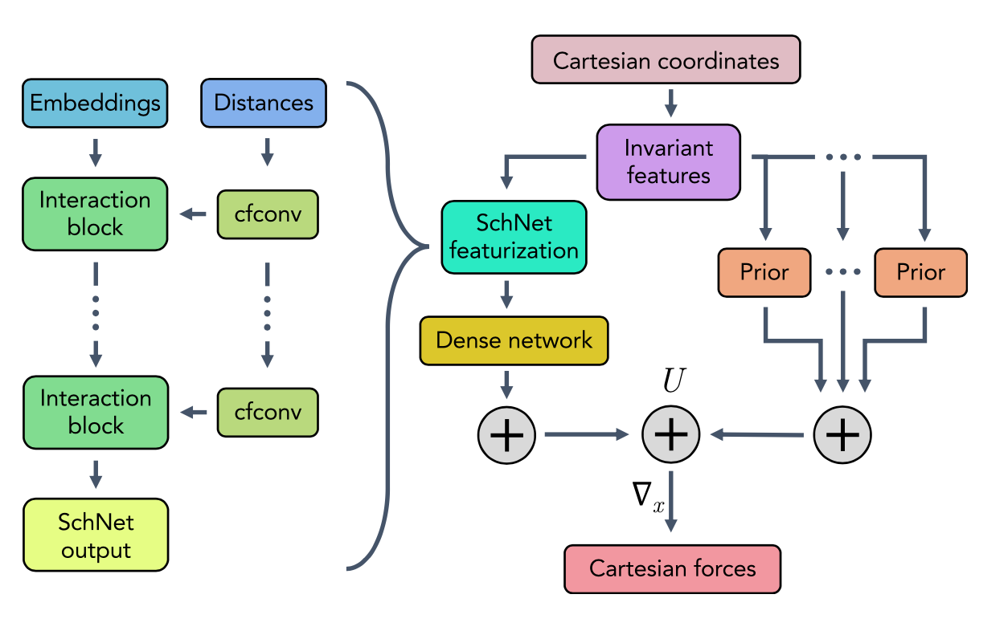
CGSchnet architecture
CGSchnet is the next iteration of the model, with graph NNs involved
The continuous filter convolutions utilized inside the GNN, and emb. layer allows to learn representations (embeddings)
Featurization preserve permutational invariance
Husic, Brooke & Charron, Nicholas & Lemm, Dominik & Wang, Jiang & Pérez, Adrià & Majewski, Maciej & Krämer, Andreas & Chen, Yaoyi & Olsson, Simon & Fabritiis, Gianni & Noé, Frank & Clementi, Cecilia. (2020). Coarse graining molecular dynamics with graph neural networks. The Journal of Chemical Physics. 153. 10.1063/5.0026133

Slide 20
Embedding layer
The motivation behind embedding usage is the same as in NLP, where embedding of each word (token) could be used to represent context in which one occurs more frequently.
If we consider alanine dipeptide CG model, we may assign the atomic number of the element to the bead. Since our beads are the backbone C-N-C-C-N, we embed the properties (6, 7, 6, 6, 7).
May atom types serve as tokens in NLP?

Slide 21
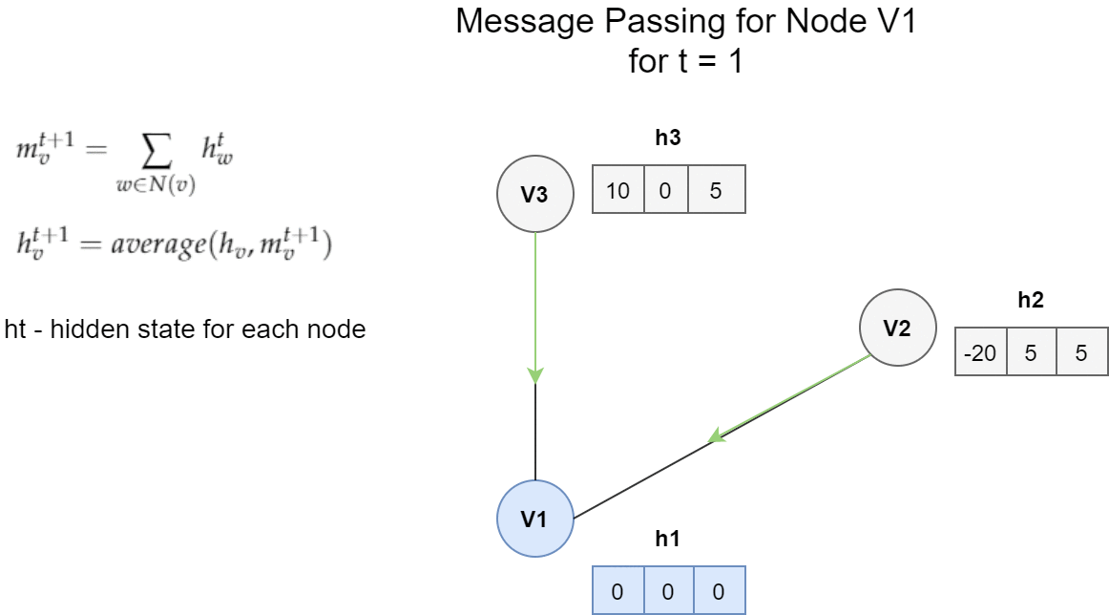
Message passing network
https://towardsdatascience.com/introduction-to-message-passing-neural-networks-e670dc103a87

Slide 22
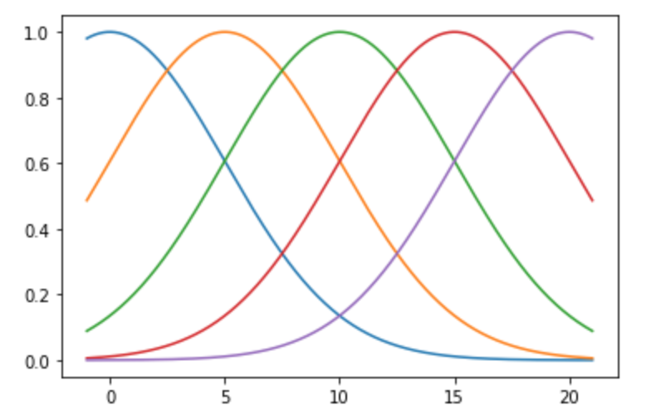
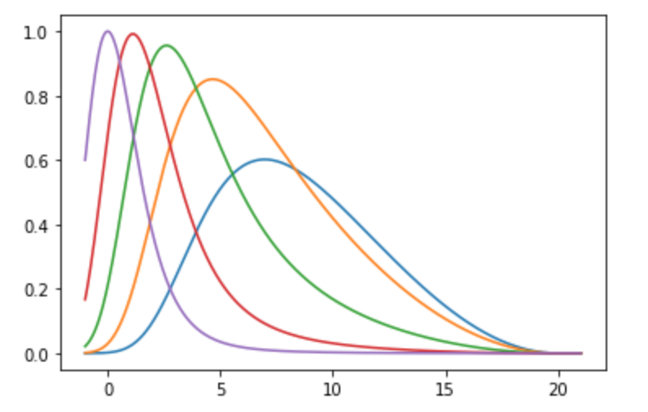
Continuous representation of interatomic distances
Before passing into the network, interatomic distances featurized using radial basis functions (exponential normal (right) or gaussians radial (left)). Number of harmonics is around 64.
X = 10
[0.1353, 0.6065, 1.0000, 0.6065, 0.1353]
X = 10
[0.4794, 0.4192, 0.1678, 0.0308, 0.0026]

Slide 23
Simulation
Once the neural network has been trained to produce a free energy U(x), it can be used to simulate dynamical trajectories of the CG model. In CGSchnet, Langevin dynamics are employed to propagate coarse-grained coordinates x_{t} forward in time according to
$\frac{∂^{2}x_{t}}{∂t^{2}}=−M^{−1}∇U\left(x_{t}\right)−γ$ $\frac{∂x_{t}}{∂t}+\sqrt{2kTγ}M^{−\frac{1}{2}}$ $W(t)$
$γ$ – collision rates;
$W(t)$ – Gaussian noise;
M – beads masses diagonal matrix.
Implementation of CGnet is vectorized, it is more efficient to compute free energies and mean forces for an entire batch of configurations, rather than a single configuration at a time.

Slide 24
Model performance assess
Husic, Brooke & Charron, Nicholas & Lemm, Dominik & Wang, Jiang & Pérez, Adrià & Majewski, Maciej & Krämer, Andreas & Chen, Yaoyi & Olsson, Simon & Fabritiis, Gianni & Noé, Frank & Clementi, Cecilia. (2020). Coarse graining molecular dynamics with graph neural networks. The Journal of Chemical Physics. 153. 10.1063/5.0026133

Slide 25
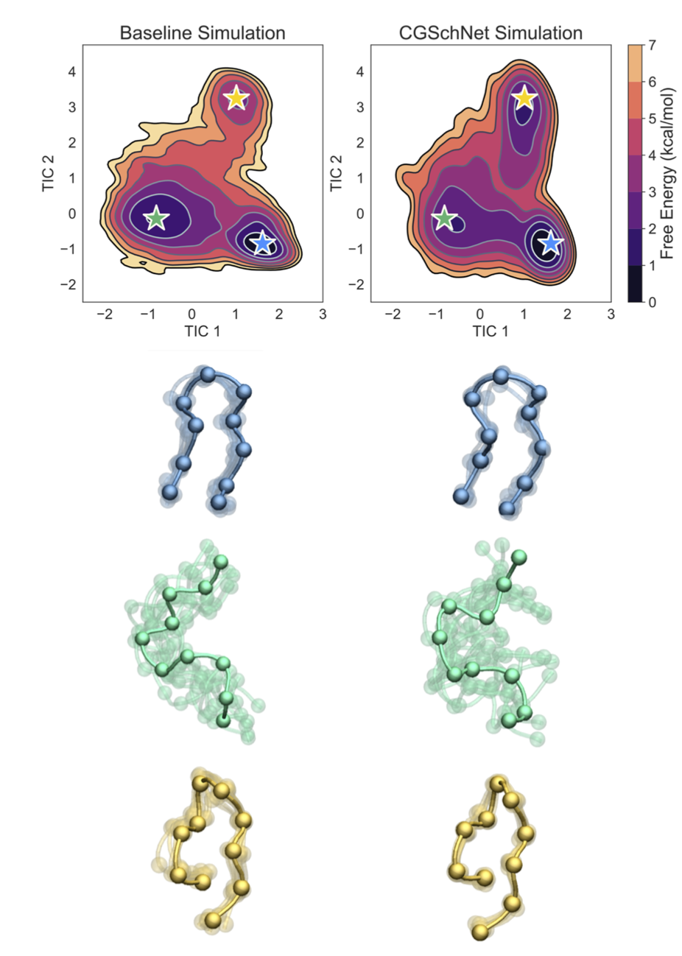
Model replication of different states
Two-dimensional free energy surfaces and sample folded, unfolded, and misfolded conformations from the baseline atomistic simulation of chignolin and the CGSchNet simulation
Husic, Brooke & Charron, Nicholas & Lemm, Dominik & Wang, Jiang & Pérez, Adrià & Majewski, Maciej & Krämer, Andreas & Chen, Yaoyi & Olsson, Simon & Fabritiis, Gianni & Noé, Frank & Clementi, Cecilia. (2020). Coarse graining molecular dynamics with graph neural networks. The Journal of Chemical Physics. 153. 10.1063/5.0026133

Slide 26
CGSchnet summary
Contribution of a bead to the coarse-grained energy should depend on its location in the molecular graph, but not at the index this bead is positioned in the input. That leads to permutation invariance;
Usage of embeddings advances architectures to transferability across various molecular systems. Embedding mapping scheme could be considered as area of active research;
Additional transformation of distances to set of values through RBFs allows to introduce more physical intuition into the model.

Slide 27
Thank you for attention

